Slide 1
Chapter 16: Greedy Algorithms
Used for optimization problems.
Idea: When we have a choice to make, make the one that looks best right now– local optimal
  Greedy algorithms don’t always yield an optimal solution.
Use activity selection to illustrate greedy technique
Some general characteristics when greedy algorithms give optimal solutions.

Slide 2
Activity selection
n activities require exclusive use of a common resource. e.g.,
  scheduling the use of a classroom,
  multi-programming in a computer
Given a set of activities S = {a1, …, an }.
  Ai: needs resource during period [si , fi ),
  si = start time
  fi = finish time.
Goal: Select the largest possible set of nonoverlapping (mutually compatible) activities.
Could have many other objectives:
  Schedule room for longest time
  Maximize income rental fees.

Slide 3
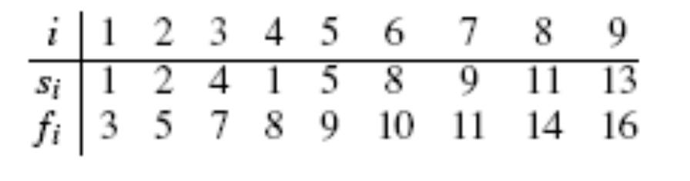
Example
S ={a1, a2, …, a9 } sorted by finish time:

Slide 4
Dynamic Programming Approach
Use dynamic programming to try this problem first
  problem formulation & optimal substructure?
Define 3 parameters
  Si,j ={activities that start after ai finishes and finish before aj starts} also denotes subproblem with activities in Si,j
  Ai,j = optimal solution to Si,j
  c[i,j]: size of Ai,j
  example

Slide 5
Problem formulation continued
Observation: activities in Si,j are compatible with
  all activities that finish by fi, and
  all activities that start no earlier than sj .
To represent the entire problem, add 2 fictitious activities:
Goal: maximize c[0,n+1]

Slide 6
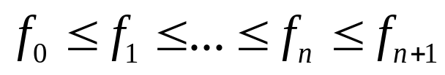
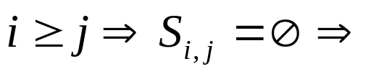
Problem formulation –continued
The whole set of activities to be scheduled S = S0,n+1
The optimal solution = A0,n+1
Activities are sorted by monotonically increasing finish time:
  Then only need to consider
  Si,j with

Slide 7
Recursion
Given an optimal solution { }

Slide 8
Optimal substructure
Suppose Ai j includes ak ,
  Break Si,j into 2 subproblems Si,k & Sk,j
  Aik = {activities in that finish before starts}
  Akj = {activities in that start before finishes}
  Aij=
  |Aij|=
Claim: Optimal solution Aij must include optimal solutions for the two subproblems for Sik and Skj => optimal substructure
  Proof
we don’t know which k to use, => try all possible ak in Si,j

Slide 9
Recursive solution, dynamic programming
#subproblems
#choices
Can be solved by dynamic programming

Slide 10
Basic Idea of Greedy-- example
i | 1 | 2 | 3 | 4 | 5 | 6 | 7 | 8 | 9
 | 1 | 2 | 4 | 1 | 5 | 8 | 9 | 11 | 13
 | 3 | 5 | 7 | 8 | 9 | 10 | 11 | 14 | 16

Slide 11
Making the greedy choice
Choose an activity to add to optimal solution before solving subproblems
  Greedy choice: activity with earliest finish time.
Leaves only one subproblem to solve:
Since have only subproblem to solve, simplify notation:
  = {activities that start after finishes}=
By optimal substructure, if a1 is in an optimal solution, then an optimal solution to the original problem consists of a1 plus all activities in an optimal solution to S1.
But need to prove that a1 is always part of some optimal solution.

Slide 12
Theorem
Let , and let be the activity in with the earliest finish time. Then:
  is included in some optimal solution.
Proof

Slide 13
Greedy approach—top down
So, don’t need full power of dynamic programming. Don’t need to work bottomup.
Instead, can just repeatedly choose the activity that finishes first, keep only the activities that are compatible with that one, and repeat until no activities remain.
Can work top-down: make a choice, then solve a subproblem. Don’t have to solve subproblems before making a choice as in dynamic programming.

Slide 14
Recursive & Iterative Greedy Algorithm
Recursive
  REC-ACTIVITY-SELECTOR (s, f, k, n)
  Initial call-- REC-ACTIVITY-SELECTOR (s, f, 0, n)
Iterative: see textbook
Complexity:

Slide 15
Greedy strategy
Take the choice that seems best at the moment --greedy
What did we do for activity selection?
  Determine the optimal substructure.
  Develop a recursive solution.
  Show that if we make the greedy choice, only one subproblem remains.
  Prove that it’s always safe to make the greedy choice.
  Develop a recursive greedy algorithm.
  Convert it to an iterative algorithm.

Slide 16
Two key ingredients for optimal solution
greedy-choice property and
optimal substructure
Greedy-choice property
  A globally optimal solution can be arrived at by making a locally optimal (greedy) choice.
No general way to tell if a greedy algorithm is optimal

Slide 17
Dynamic programming vs greedy algorithm
Dynamic programming:
  Make a choice at each step.
  Choice depends on knowing optimal solutions to subproblems. Solve subproblems first.
  Solve bottom-up.
Greedy:
  Make a choice at each step.
  Make the choice before solving the subproblems.
  Solve top-down.

Slide 18
Greedy vs. dynamic – example: knapsack problem
0-1 knapsack problem
  n items.
  Item i is worth $ , weighs pounds.
  Find most valuable subset of items with total weight W
  Have to either take an item or not take it—can’t take part of it.
Fractional knapsack problem
  Like the 0-1 knapsack problem, but can take fraction of an item.
Both have optimal substructure.
Greedy-choice property?
  Yes for fractional knapsack problem
  No for 0-1knapsack problem

Slide 19
Greedy algorithm for fractional knapsack problem
Greedy on value/weight
Example:

Slide 20
Chapter summary
Basic idea of greedy algorithm
Why optimality is not guaranteed
Activities selection problem.
Greedy vs dynamic

